Slide 1









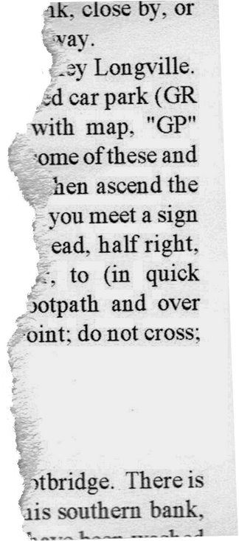



what question to be asked
Student
Feedback
what are the parameter to be used
FOR PRIMARY SCHOOL STUDETNS

Slide 2









Feedback
manifesting ~ manifesting ~ manifesting ~
Feedback in simple terms is the information about individual performance or behaviour with the intention of improving
It can either be positive or negative and can be taken verbally, audio etc etc
Questions
Then in order to get the right feedback we need to ask the right kind of questions
how would you take it

Slide 3





Parameters
Asking directly what is the feedback is not good...the one who is giving the feedback may not think in all angles while giving it
we need some parameters to on which we have to take feedback to get the correct interpretation of the subject
Back to Agenda Page
manifesting ~ manifesting ~ manifesting ~

Slide 4




Teachign style
Knowledge about subject
communication skills
Teacher
class room management
continuous learning
flexibility
Their are many parameters on which we can take review about the teacher but the primary school students may not understand all of them so we need to shortlist them
professioinalism

Slide 5
manifesting ~ manifesting ~ manifesting ~
Importance
Scope
Difficulty
Subject
Resources
Learning outcome
Assessment
Review about the subject is one of the tricky part the parameters about defining this hard to convey to students
Relevance

Slide 6


1
Choosing the right kind of parameters which does not affect one another is crucial
They usually effect one another
How they might effect
2
Teacher
The parameter which are being chosen should be easily answerable to students.
3
Subject
Combined
BUt on the whole it is also important to know whats the out come when combined
Write comments, ideas, or reminders here
Just copy and paste to duplicate this sticky note or press "S" as a keyboard shortcut

Slide 7


Emotional State
1
1-1 interaction with the teacher
2
Class environment
3
Freeness or how openly they will be
4
Beating or anything.
5
explaining when needed
6
other open-ended questions
1

Slide 8


Emotional State
1
Easy or not
2
Enjoying or not
3
Single or group
4
Interesting.
5
expected marks
6
other open-ended questions
manifesting ~ manifesting ~ manifesting ~
1

Slide 9


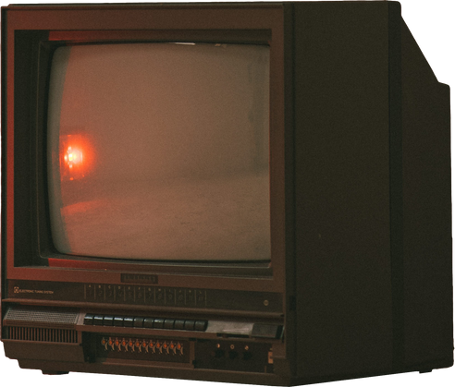

Activites
What kind of activities are used effects the review , their should be less chance of bias cause their might be change of out come from the students when asked the same question repetadly

Slide 10
Emoji Selection
for the questions of range type of answers
Match the following
for prioritizing
Fill in the blanks
a different way of choosing things
Audio recording
for the answers of no possible options
Grouping like things together
1
2

